Slide 1
DC Biasing – BJTs
Topic 4 (Chapter 4)
(Some materials are from Malvino’s book)

Slide 2
Biasing
Biasing: Applying DC voltages to a transistor in order to turn it on so that it can amplify AC signals.

Slide 3
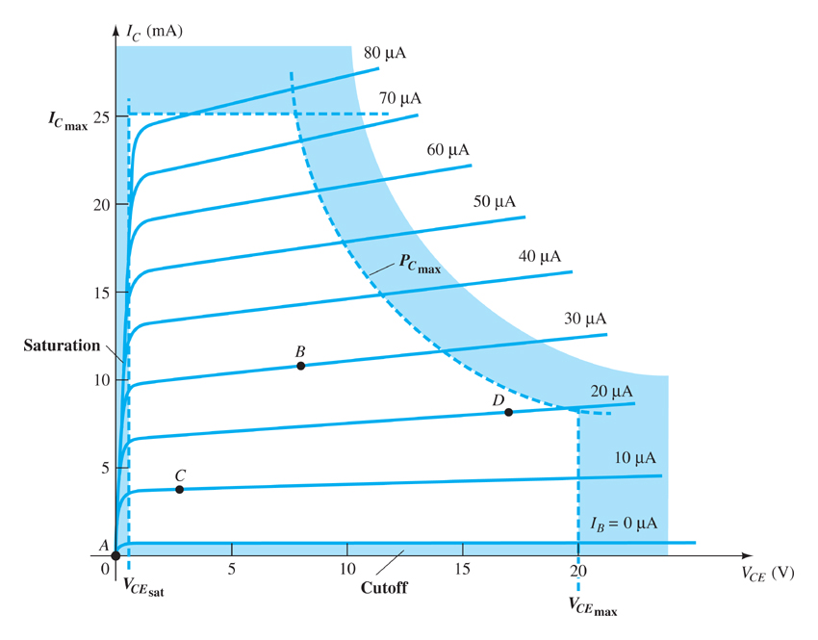
4.2 Operating Point
The DC voltages establishes an operating or quiescent point
called the Q-point.

Slide 4
The Three Operating Regions
    Active or Linear Region Operation
    Base–Emitter junction is forward biased
        Base–Collector junction is reverse biased
        BJT works as an Amplifier
    Cutoff Region Operation
    Base–Emitter junction is reverse biased
    Base–Collector junction is reverse biased
    BJT works as an OFF Switch
    Saturation Region Operation
    Base–Emitter junction is forward biased
    Base–Collector junction is forward biased or near forward bias
    BJT works as an ON Switch

Slide 5
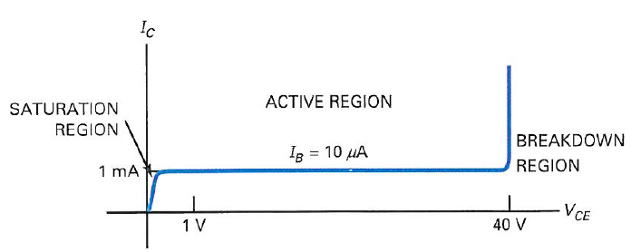
Regions of operation
Cutoff Region
Active - - - used for linear amplification
Cutoff - - - used in switching applications (OFF)
Saturation - - - used in switching applications (ON)
Breakdown - - - can destroy the transistor and should be avoided

Slide 6
DC Biasing Circuits
Fixed-bias or Base-Bias
Emitter Bias
Voltage divider bias circuit
DC bias with voltage feedback

Slide 7
4.3 Base-Bias or Fixed-Bias
Setting up a fixed value of base current
Base current remains constant for given values of V_{BB}
Usually V_{BB} and V_{CC}
are the same supply
1 kΩ
R_{C}
V_{CE}
12 V
V_{CC}
R_{B}
V_{BB}
12 V

Slide 8
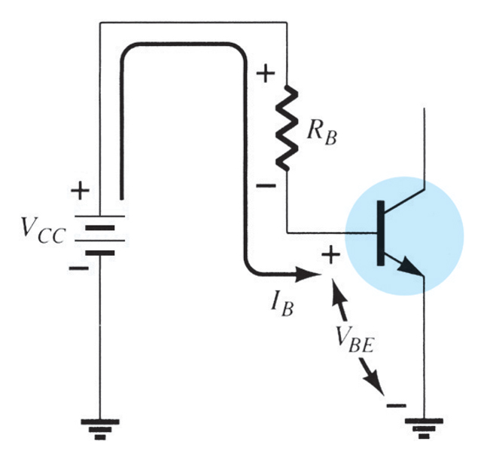
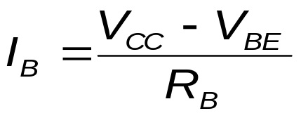
The Base-Emitter Loop
From Kirchhoff’s voltage law:
+V_{CC} – I_{B}R_{B} – V_{BE} = 0
Solving for base current:

Slide 9
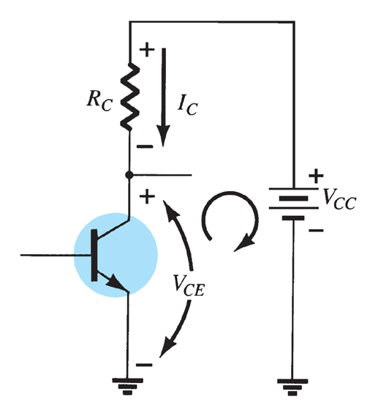


Collector-Emitter Loop
Collector current:
From Kirchhoff’s voltage law:

Slide 10
Load line
A visual summary of all the possible transistor operating points
Connects saturation current (I_{Csat}) to cutoff voltage (V_{CEcutoff} )

Slide 11
Load line
V_{CC} - V_{CE}
A graph of this equation
produces a load line.
I_{C} =
R_{C}
14
100 μA
12
80 μA
10
60 μA
I_{C} in mA
8
6
40 μA
4
20 μA
2
0 μA
0
2
4
6
8
10
12
14
16
18
V_{CE} in Volts

Slide 12
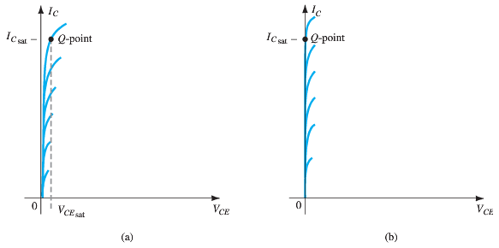
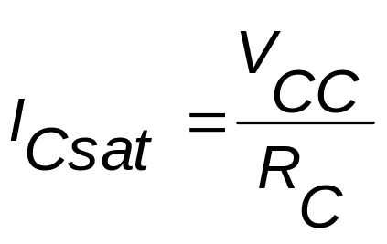
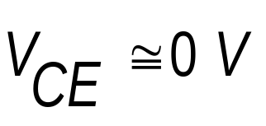
Saturation
When the transistor is operating in saturation, current through the transistor is at its maximum possible value.

Slide 13
Understanding Saturation
12 V
I_{C} =
1 kΩ
1 kΩ
R_{C}
Mental
short
12 V
V_{CC}
R_{B}
V_{BB}
12 V

Slide 14
Understanding Saturation
12 V
This is the
Saturation (maximum) current.
I_{C} =
= 12 mA
1 kΩ
14
100 μA
12
80 μA
10
60 μA
I_{C} in mA
8
6
40 μA
4
20 μA
2
0 μA
0
2
4
6
8
10
12
14
16
18
V_{CE} in Volts

Slide 15
Understanding Cutoff
1 kΩ
R_{C}
Mental
open
12 V
V_{CC}
R_{B}
V_{BB}
12 V

Slide 16
Understanding Cutoff
V_{CE(cutoff)} = V_{CC}
14
100 μA
12
80 μA
10
60 μA
I_{C} in mA
8
6
40 μA
4
20 μA
2
0 μA
0
2
4
6
8
10
12
14
16
18
V_{CE} in Volts

Slide 17

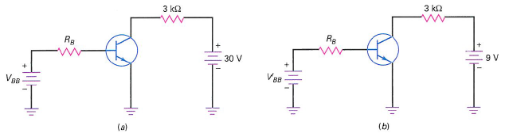
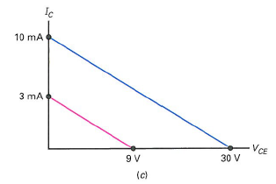

Slide 18
4.4 Emitter bias:
Contains an emitter resistor
1 kΩ
1 kΩ
R_{C}
V_{BB} - V_{BE}
I_{C} ≅ I_{E}
I_{E} =
= 1.95 mA
R_{E}
15 V
V_{CC}
2.2 kΩ
R_{E}
V_{BB}
5 V
V_{C} = 15 V - (1.95 mA)(1 kΩ) = 13.1 V
V_{CE} = 13.1 V - 4.3 V = 8.8 V

Slide 19
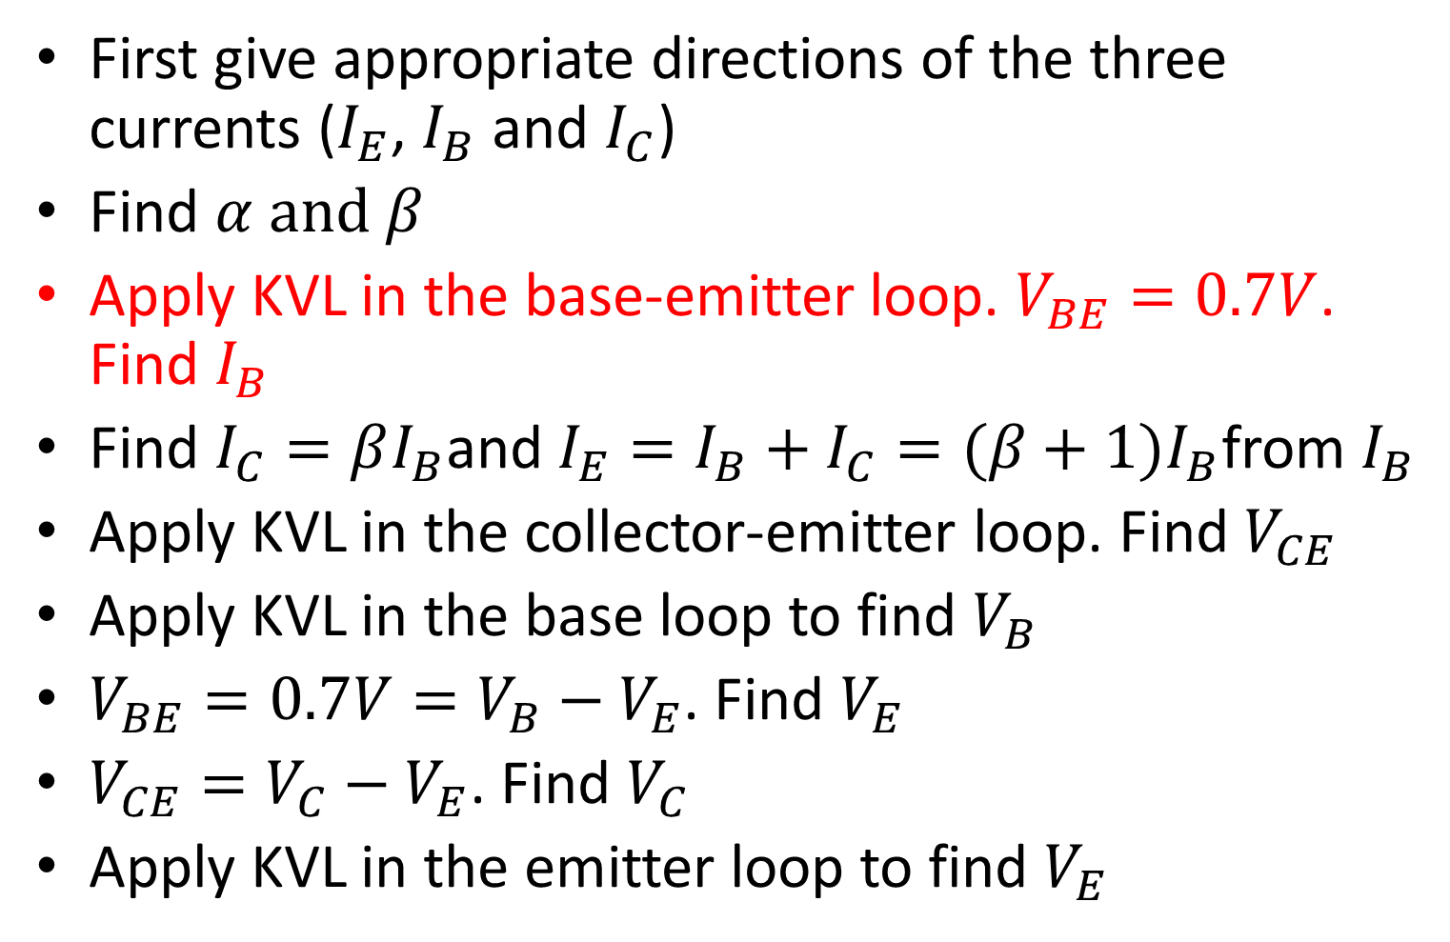
BJT DC biasing
First give appropriate directions of the three currents ($I_{E}$, $I_{B}$ and $I_{C}$)
Find $α and β$
Apply KVL in the base-emitter loop. $V_{BE}=0.7V$. Find $I_{B}$
Find $I_{C}=βI_{B}$and $I_{E}=I_{B}+I_{C}=(β+1)I_{B}$from $I_{B}$
Apply KVL in the collector-emitter loop. Find $V_{CE}$
Apply KVL in the base loop to find $V_{B}$
$V_{BE}=0.7V=V_{B}−V_{E}$. Find $V_{E}$
$V_{CE}=V_{C}−V_{E}$. Find $V_{C}$
Apply KVL in the emitter loop to find $V_{E}$

Slide 20
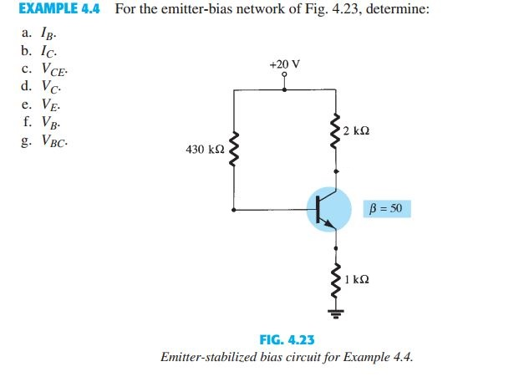
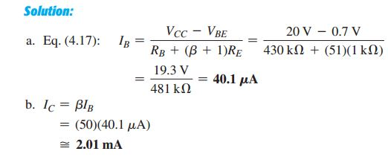
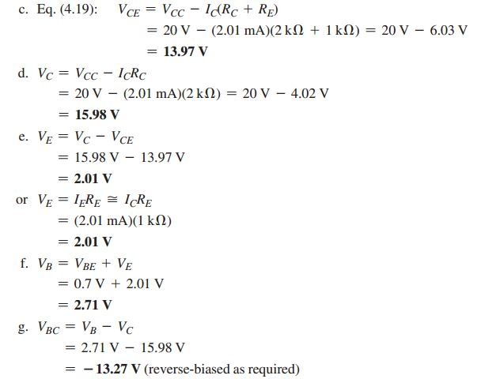

Slide 22
4.5 Voltage divider bias
+V_{CC}
Base circuit contains a voltage divider
Most widely used
Known as VDB
R_{C}
R₁
R₂
R_{E}

Slide 23
Voltage divider bias circuit
{
+V_{CC}
R_{C}
R₁
R₁ and R₂ form
a voltage divider
R₂
R_{E}

Slide 24
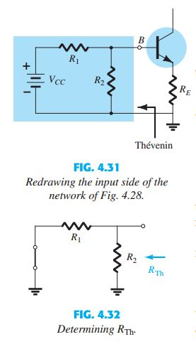
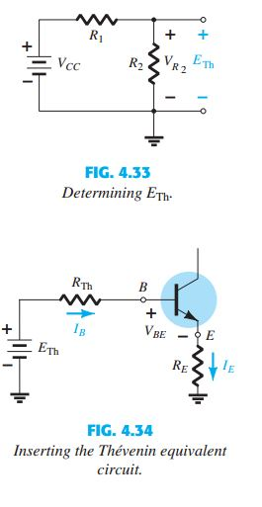

Divider analysis:
R_{th} = R₁ || R₂
E_{th} =
R₂
V_{CC}
R₁ + R₂

Slide 25
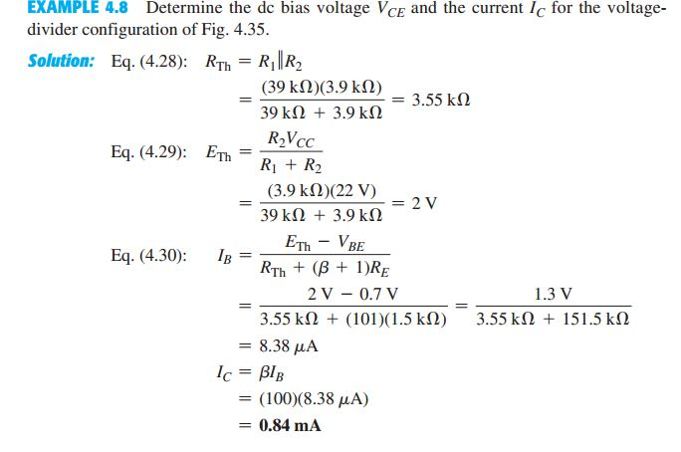
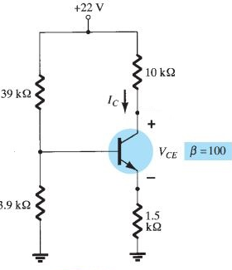
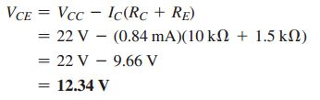

Slide 26
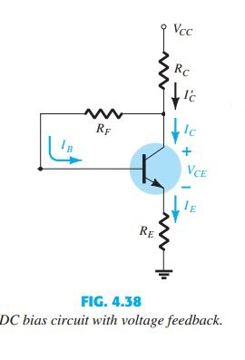
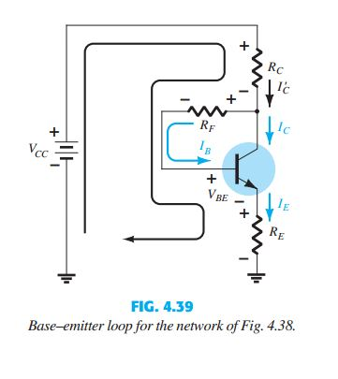

4.6 Collector-feedback bias
Our text calls it DC Bias With Voltage Feedback
Current through $R_{C}=I_{R_{C}}=I_{C^{′}}$
$$I_{C^{′}}=I_{C}+I_{B}$$

Slide 27
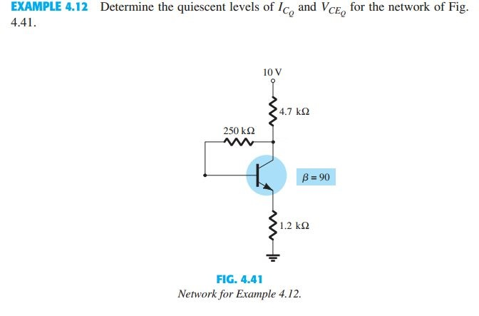
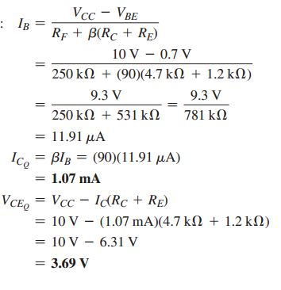

Slide 28
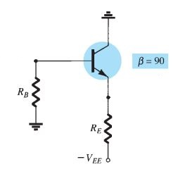
4.7 EMITTER-FOLLOWER CONFIGURATION
The output is taken off the emitter terminal
Also called Common Collector configuration

Slide 29
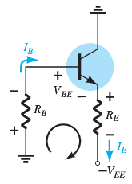



EMITTER-FOLLOWER DC ANALYSIS

Slide 30
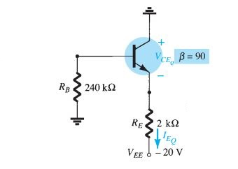
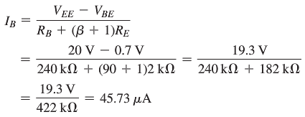
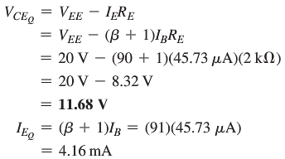

Slide 31
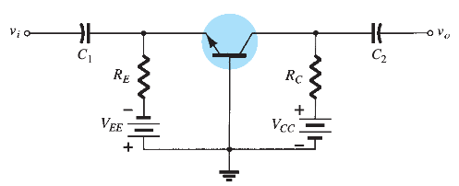
4.8 COMMON-BASE CONFIGURATION
The input signal is applied at the emitter terminal
The base is at ground potential.
The output signal is applied at the collector terminal

Slide 32
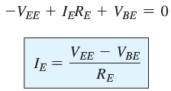
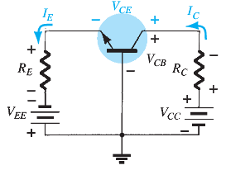
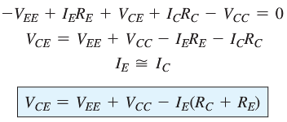
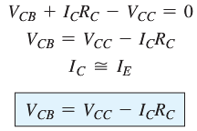
COMMON-BASE CONFIGURATION

Slide 33

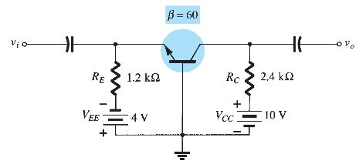
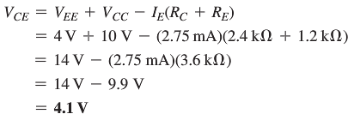
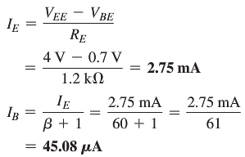
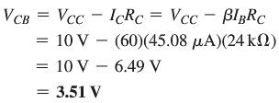

Slide 34
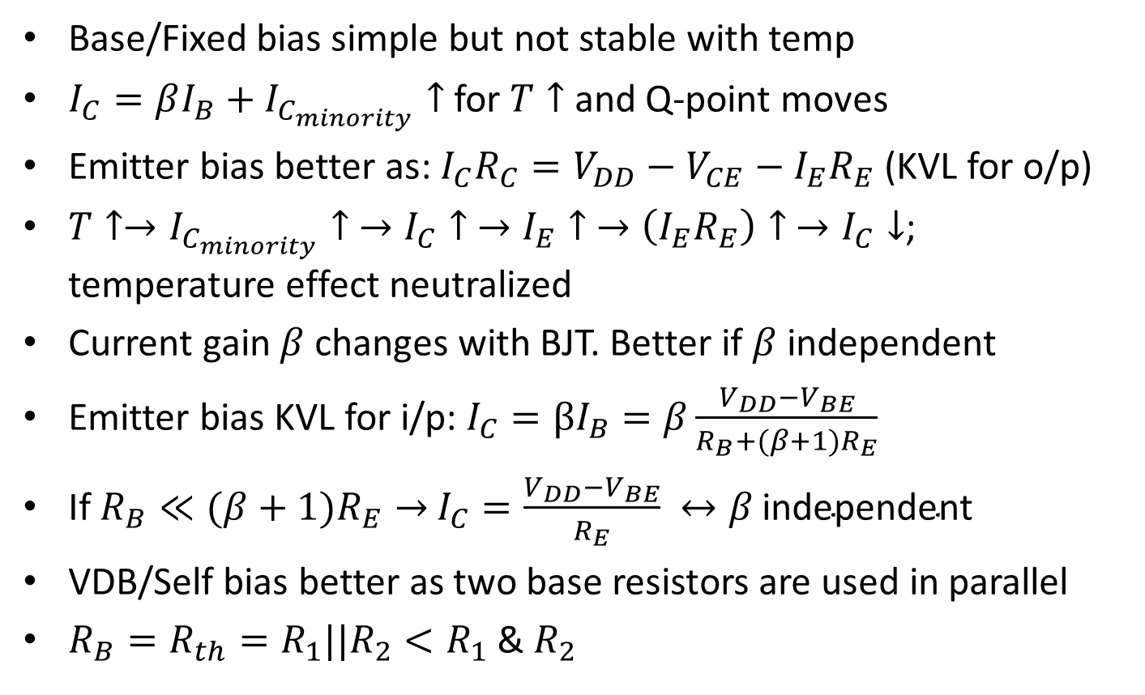
Which Bias is better?
Base/Fixed bias simple but not stable with temp
$I_{C}=βI_{B}+I_{C_{minority}}↑$ for $T↑$ and Q-point moves
Emitter bias better as: $I_{C}R_{C}=V_{DD}−V_{CE}−I_{E}R_{E}$ (KVL for o/p)
$T↑→I_{C_{minority}}↑ →I_{C}↑ →I_{E}↑ →\left(I_{E}R_{E}\right)↑ →I_{C}↓$; temperature effect neutralized
Current gain $β$ changes with BJT. Better if $β$ independent
Emitter bias KVL for i/p: $I_{C}=βI_{B}=β\frac{V_{DD}−V_{BE}}{R_{B}+(β+1)R_{E}}$
If $R_{B}≪(β+1)R_{E}→$ $I_{C}=\frac{V_{DD}−V_{BE}}{R_{E}} ↔β \text{independent}$
VDB/Self bias better as two base resistors are used in parallel
$R_{B}=R_{th}=R_{1}||R_{2}<R_{1}$&${ R}_{2}$

